Slide 1

A Fusion Approach to Infrared and Visible Images
Date: 11 May 2021
Ms. RAHELA MAHENAZ : 17WH1A0595
Ms. P. DIVYA REKHA : 18WH5A0515
Ms. A. SRAVYA : 17WH1A0590
Internal Guide: Ms.G.NAGAMANI
Designation: Assistant Professor
Department of Computer Science & Engineering
BVRIT HYDERABAD College of Engineering for Women

Slide 2
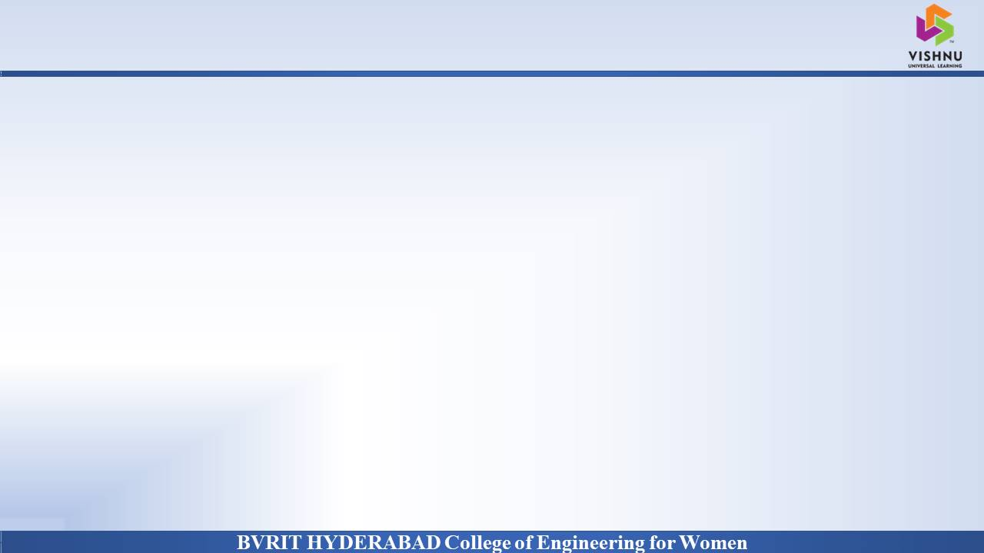
Why Should I Study this course?
ABSTRACT
Examples
We are using a novel deep learning architecture for infrared and visible images fusion. In contrast to conventional convolutional networks, our encoding network is combined with convolutional layers, a fusion layer, and dense block in which the output of each layer is connected to every other layer. We attempt to use this architecture to get more useful features from source images in the encoding process, and two fusion layers are designed to fuse these features. Finally, the fused image is reconstructed by a decoder.
BVRIT HYDERABAD College of Engineering for Women

Slide 3
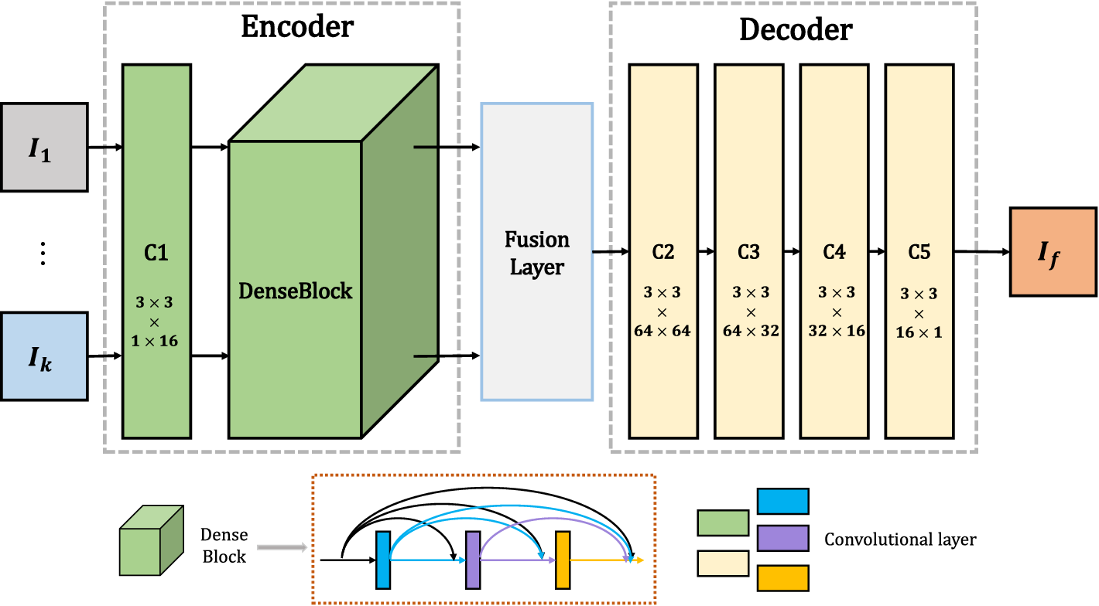
Why Should I Study this course?
Architecture
Examples
BVRIT HYDERABAD College of Engineering for Women

Slide 4
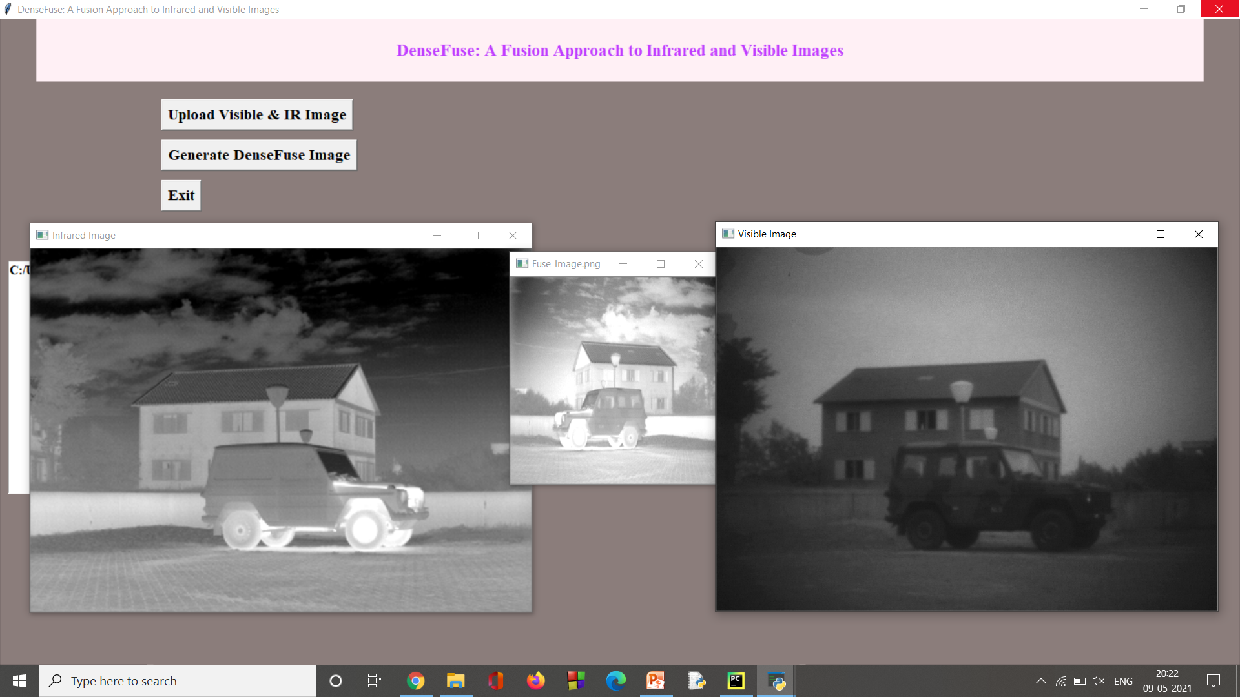
Why Should I Study this course?
OUTPUT
Examples
BVRIT HYDERABAD College of Engineering for Women

Slide 5
Thank You
BVRIT HYDERABAD College of Engineering for Women

